Slide 1

Creating a tree of Nodes and enables user to do the following functions:
  ADD
  Search
  Size
  Remove
  Display
  max-level
  Exit

Slide 2

First class called Node contain:
  Declare the Node property.
  Set & get data methods.
  Set & get left methods.
  Set & get right methods.
  Set & get level methods.

Slide 3

Second class called TreeNode contain:
  Add method.
  Search method.
  Size method.
  Remove method.
  Display method.
  Max-level method.

Slide 4
Third class called TestTree contain:
  Main Method:
      Objects for Tree class.
      call Scanner class to allow the users insert values.
      While and if conditions to control the output to the user

Slide 5

public Tree(){
head = null;
num=0;
level=0;
max=0;
}
public Node(int newData){
data = newData;
linkleft = null;
linkright = null;
level=0;
}

Slide 6

class Node {
private int data,level;
private Node linkleft,linkright;
public Node(int newData){
data = newData;
linkleft = null;
linkright = null;
level=0;
}
public int getData(){
return data;
}
public Node getleft() {
return linkleft;
}
public Node getright() {
return linkright;
}
public int getlevel(){
return level;
}
public void setlevel(int key){
level=key;
}
public void setData(int newData){
data = newData;
}
public void setleft(Node newLink) {
linkleft = newLink;
}
public void setright(Node newLink) {
linkright = newLink;
}
}

Slide 7

If Binary Search Tree, T is empty
newNode become as a root
Else
if the data in a newNode is greater than the data in the current node subtree
newNode will be insert in right subtree
else
newNode will be insert in left subtree
15
10
33
51
4
77

Slide 8

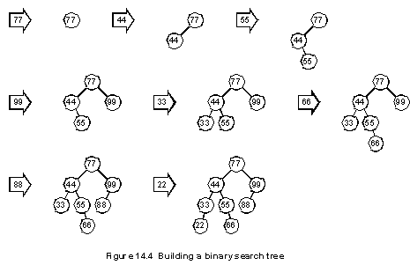

Slide 9

if (Tree is empty)
      return false
else if (desiredData == root )
      return true
else if (desiredData < the data in the root of Tree)
      return Search(left subtree of Tree , desiredData )
else
      return Search(right subtree Tree, desiredData )

Slide 10

The remove method must receive an entry to be matched in the tree
    If found, it is removed
    Otherwise not found
Three cases
      The node has no children, it is a leaf (simplest case)
      The node has one child
      The node has two children

Slide 11

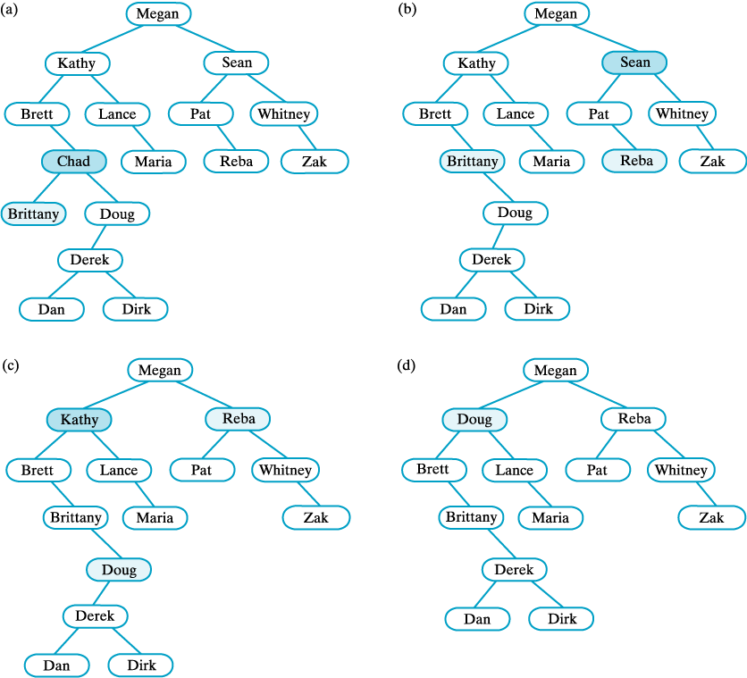

Slide 12

(c) after removing Sean;
(d) after removing Kathy.

Slide 13

Display pre-order.
Display post-order.
Display IN-order.
Display Level-order.

Slide 14

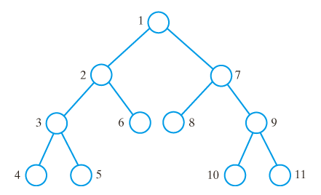
Visit the node.
Traverse the left subtrees.
Traverse the right subtrees.

Slide 15

public void displayPre(Node display){
if (isEmpty())
System.out.println("is empty");
else {
System.out.println( display.getData()+" level#"+display.getlevel());
if(display.getleft()!=null)
displayPre(display.getleft());
if (display.getright()!=null)
displayPre(display.getright());
}}

Slide 16

Traverse the left subtrees.
Visit the node.
Traverse the right subtrees.

Slide 17
public void displayIN(Node display){
if (isEmpty())
System.out.println("is empty");
else {
if (display.getleft()!=null )
displayIN(display.getleft());
System.out.println( display.getData()+" ");
if (display.getright()!=null)
displayIN(display.getright());
}
}

Slide 18

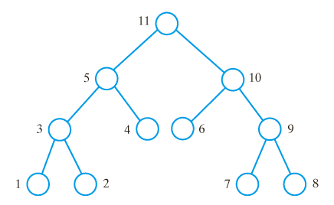
Traverse the left subtrees.
Traverse the right subtrees.
Visit the node.

Slide 19

public void displayPost(Node display){
if (isEmpty())
System.out.println("is empty");
else {
if (display.getleft()!=null )
displayPost(display.getleft());
if (display.getright()!=null)
displayPost(display.getright());
System.out.println( display.getData()+" ");
}
}

Slide 20

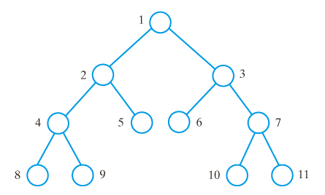
Begin at the root, visit nodes one level at a time.

Slide 21

public void displayLevel(Node display){
if (isEmpty())
System.out.println("is empty");
else {
if(display.getlevel()==level)
System.out.println( display.getData()+" level#"+display.getlevel());
if(display.getleft()!=null)
displayLevel(display.getleft());
if (display.getright()!=null)
displayLevel(display.getright());
}}
public void displayLevel(){
int f=MaxLevel(head);
level=0;
while(level<=f){
displayLevel(head);
level++; }
}

Slide 22


